Slide 1
SOFTWARE PROCESS MODELS
Chapter 04

Slide 2
Acknowledgement
Some of the contents are adapted from the contents by Prof. Tony Tang

Slide 3
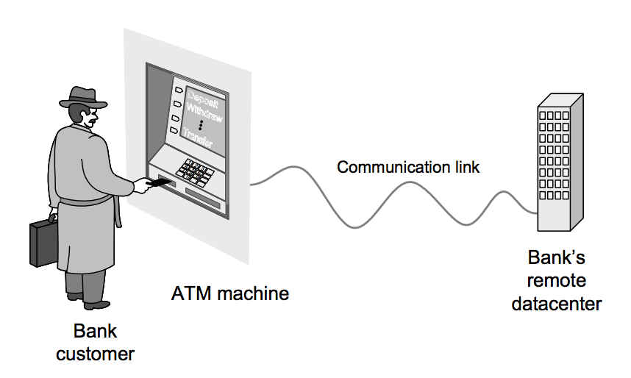
Notes:
http://www.ece.rutgers.edu/~marsic/books/SE/book-SE_marsic.pdf

Slide 4
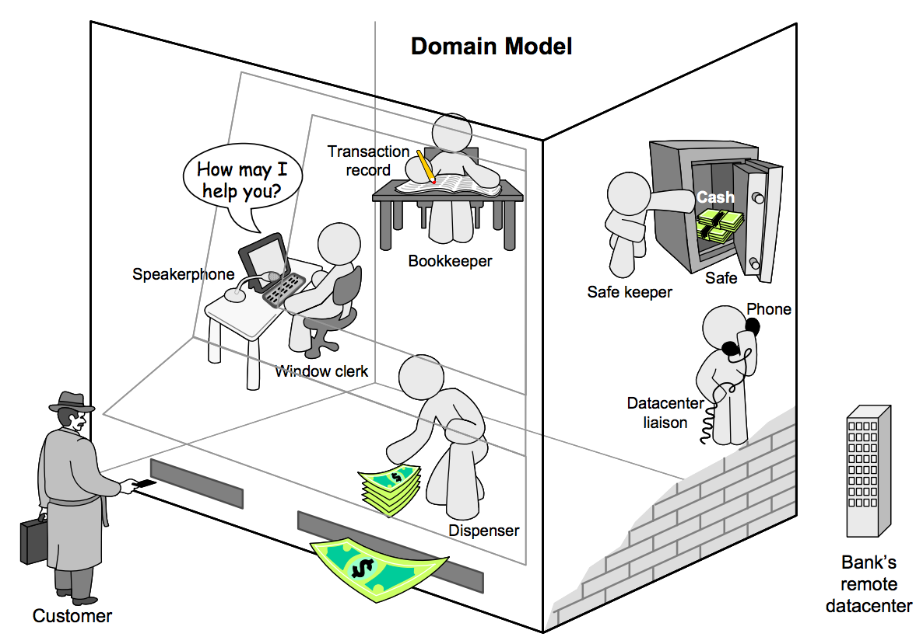
Notes:
Static: what the components are

Slide 5
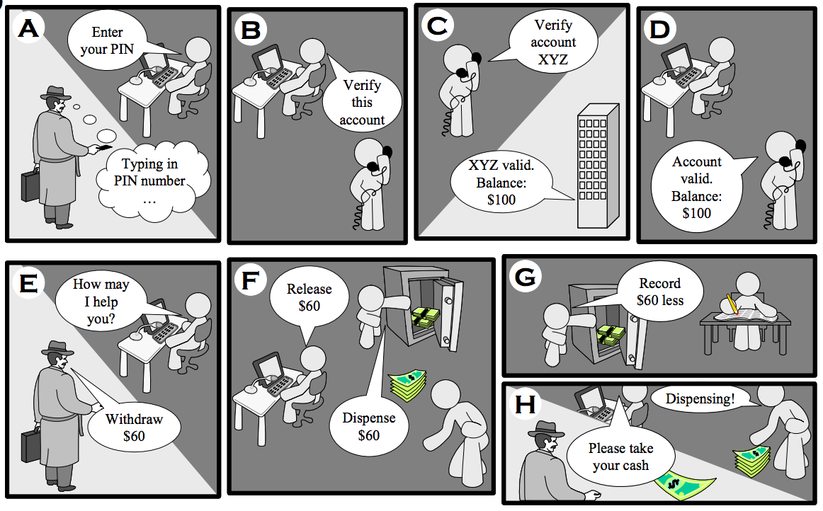
Notes:
Dynamic: how the pieces communicate with one another – i.e. the processes

Slide 6
Domain Model
A system of abstractions used to describe a domain.
Captures real-world concepts, rules, components and processes.
Uses the vocabulary of the domain, so that the representation can be reviewed and used to communicate with stakeholders.
The model can be used to help us (software engineers) understand that domain, and it can be used to help us figure out what needs to be built.

Slide 7
Variation in Target Domain
Memory Game for iPhone
Street Fighter
Microsoft Word
Electronic health records for Alberta Health
WestJet website
Flight control system
Most clients are non-technical stakeholders, and think in terms of “business needs”/language
Similarly, we are rarely (if ever) experts in the target domain
Building the domain model provides a “boundary object” that we can both talk about and reason about

Slide 8
Variation in Target Domain
Memory Game for iPhone
Street Fighter
Microsoft Word
Electronic health records for Alberta Health
WestJet website
Flight control system
Some projects have well-defined parameters up front
Most do not, where requirements change
Stakeholder client organizations are not always stable either
Some projects have stakeholders who are more readily available for feedback than others
Notes:
Okay, so how do we get there?

Slide 9
Software Development Process Models
Process models describe strategies for teams, outlining:
  activities that will need to be done
  when they ought to be done (in relation to one another)
  how team interacts with itself and outside world
  work products that will be produced
As with the domain model, they’re a simplification/abstraction
Purpose: help us to get things done on time, on budget, “correctly” (from a software perspective, and a client perspective) and gives us an understanding of what we all ought to be doing
Notes:
Legal issues, too

Slide 10
Process Models Overview
Waterfall model
Incremental
Rapid Application Development model
Prototyping model
Spiral model
Agile

Slide 11
The Waterfall Model
Sometimes called the classic life cycle or the linear sequential model.
Follows a sequential approach
Oldest process model
Activities are:
  Communication
  Planning
  Modeling
  Construction
  Deployment

Slide 12
Waterfall Model…
C
o
m
m
u
n
i
c
a
t
i
o
n
p
r
Planning
o
j
e
c
t
i
n
i
t
i
a
t
i
o
n
r
e
q
u
i
r
e
m
e
n
t
g
a
t
h
e
r
i
n
g
estimating
M
o
d
e
l
i
n
g
scheduling
C
o
n
a
n
s
t
r
u
c
t
i
o
n
a
l
y
ss
i
tracking
d
e
s
i
g
n
D
e
p
l
o
y
m
e
n
c
o
d
t
e
d
e
l
i
v
e
r
t
e
s
t
y
s
u
p
p
o
r
t
f
e
e
d
b
a
c
k

Slide 13
The Waterfall Model
A useful process model in the following situations:
  Fixed Requirement
  Works in a linear manner
Disadvantages:
  It is difficult for a customer to state all the requirements explicitly.
  The customer must have patience.
  Real projects rarely follow the sequential flow that the model proposes.

Slide 14
The Incremental Model
Apply elements of waterfall model in an iterative fashion.
Each linear sequences produce deliverables ‘Sequence’ of the software.
First increment is known as “Core Product”
  Basic requirements are addressed
  Many features remain undelivered
    Some known
    Some unknown

Slide 15
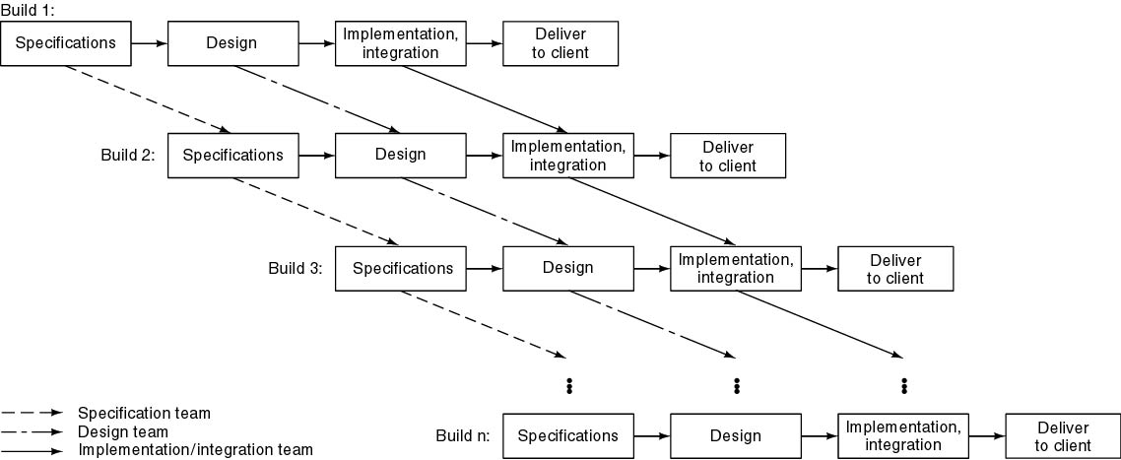
The Incremental Model…

Slide 16
The Incremental Model
  Core product is used / evaluated by the customer
  A plan is developed for the next increment
  Modification in the core product is done
  The process goes on until the complete product is produced
  Useful when staffing is unavailable or you have fewer people

Slide 17
The RAD Model
Known as “Rapid Application Development”
An extremely short development cycle
High speed form of Linear Sequential Model
Model emphasizes component-based construction
Concept of “RAD Team”
Fully functional system within a very short span of time (60 – 90 days)

Slide 18
The RAD Model
Drawbacks
  RAD requires sufficient human resources to create RAD teams
  RAD requires developers and customers both should be committed
  A system must be properly modularized.
  RAD is not appropriate when technical risks are high
  Not all type of applications are appropriate for RAD

Slide 19
The Prototyping Model
A customer defines a set of general objectives for SW but does not identify detailed input, processing, or output requirements.
Better understanding what is to be built, if requirements are fuzzy
The prototype can serve as “the first system”
Users get a feel for the actual system and developers get to build something immediately

Slide 20
The Prototyping Model
Disadvantages/problems:
  Developers has to compromise with the user
  When the factors like, quality and long term maintainability are considered, the customer always demands that a few modifications can make the prototype a working product

Slide 21
The Prototyping Model
Advantages
  Customer is always satisfied.
  Developers need less time to produce a good engineer product
The customer and developer must agree that the prototype is built to serve as a mechanism for defining requirements.

Slide 22
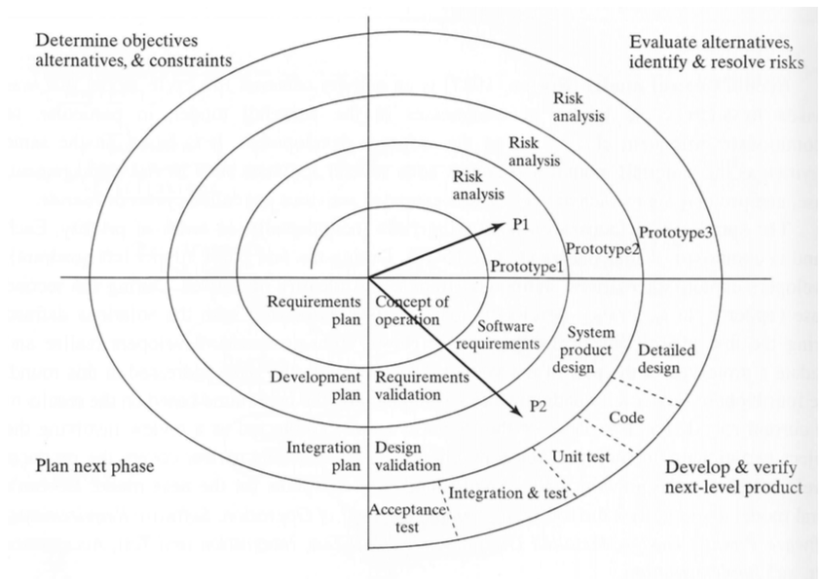
Spiral Model
Spiral model is an iterative model where the focus is identifying and addressing risks
Each spiral (called a “round”) is comprised of four phases:
Exploring alternatives, identifying objectives
Risk analysis
Development and verification
Planning of next phase
Notes:
Basically, this recognizes that risk is something that is something frequently introduced and is out of our control, and the model accounts for this by allowing us to deal with it when it comes up
e.g. over-scheduled/over-budget; exit/entry of personnel; dependncies on other products
e.g. poor design choices, poor performance; usability, change

Slide 23
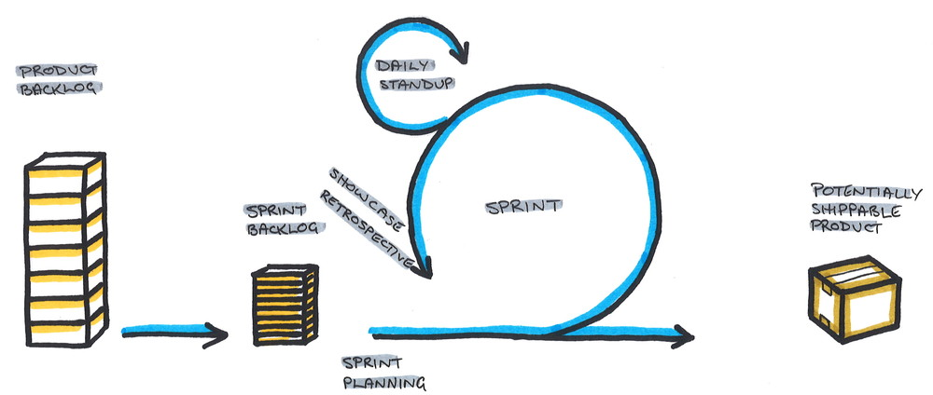
Agile Processes
“New hotness” (as of 2005)
Idea: frequently delivering working software (as opposed to documentation) to get feedback from customers
Requires: close communication with stakeholders and negotiability of everything (things change!)
Work is organized as a set of “sprints” rather than being planned out long in advance
Challenge: same with prototype/iterative approaches
Notes:
http://pragma.team/blog-list/2016/2/19/agile-the-why-the-how-the-who

Slide 24
Which is better?
Predictive approaches (plan-driven)
high criticality
stable requirements
large team
culture demands order
Adaptive approaches (“agile”)
low criticality
volatile requirements
small team
culture is supportive of negotiation

Slide 25
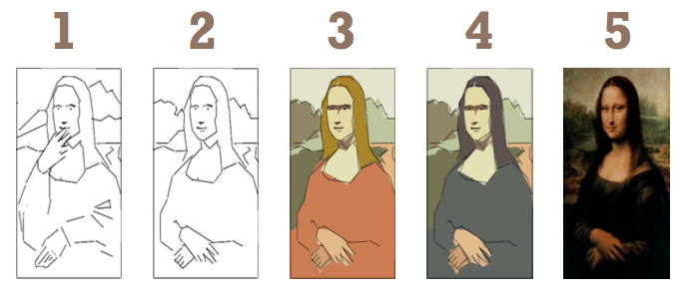
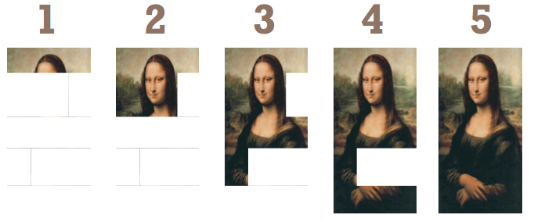
Incremental vs. Iterative
Iterative:
  successive approximations to total solution
Incremental:
  portions of the system at a time
Notes:
Jeff Pa8on: www.AgileProductDesign.com

